Slide 1

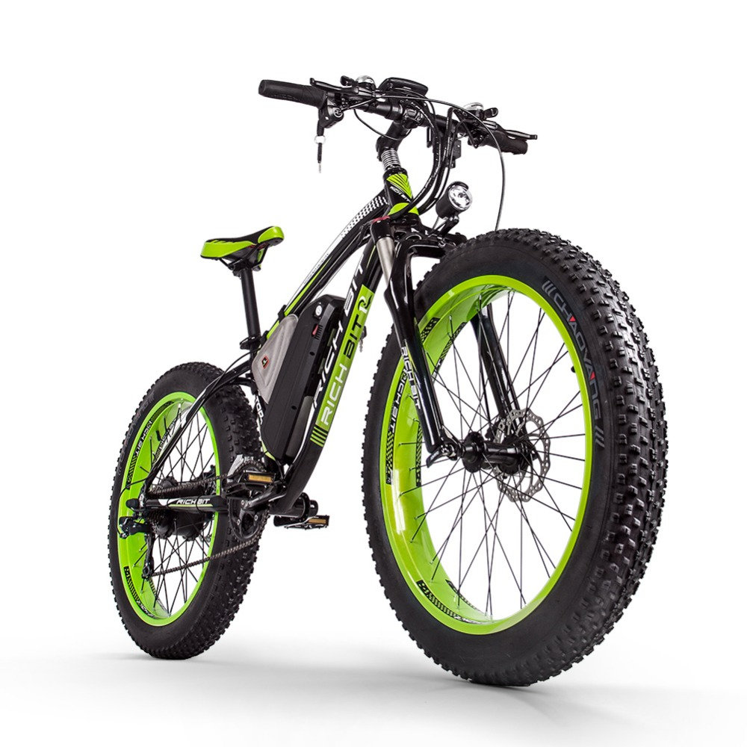
ADVENTURE WORKS CYCLE
MANUFACTURING ANALYTICS

Slide 2
Team Members:
Usha R. Bagal
Rohini Mali
Preethi K R
Darshani S.Solanki
Pooja Midage

Slide 3
About Company
Business Problems
Agenda
Transformation Challenges
Data Model
Dashboard Overview
Conclusion
Suggestions

Slide 4
ABOUT COMPANY
Adventure Works Cycles: A Multinational Manufacturing Company
Overview of Operations: Metal and Composite Bicycles
Market Presence: North America, Europe, Asia
Manufacturing Plant in Mexico & Base Operations in Bothell, Washington.
Key Products: Road Bikes , Mountain Bikes & Touring Bikes
2000
2001
AWC bought a manufacturing plant in Mexico
AWC became sole manufacturer and distributor of the touring bicycle and product group.

Slide 5
BUSINESS PROBLEMS
Sales Optimization
Customer Segmentation and Targeting
E-commerce Optimization
Identifying sales strength
Improving Marketing Strategies
Focus on boosting sales and market share to our best customers
The company aims to extend its products availability through an external website
Operational Efficiency
Market Expansion Strategies
Adventure works cycle company aims to reduce the production cost
Adventure works cycle company wants to expand its presence in the Market

Slide 6
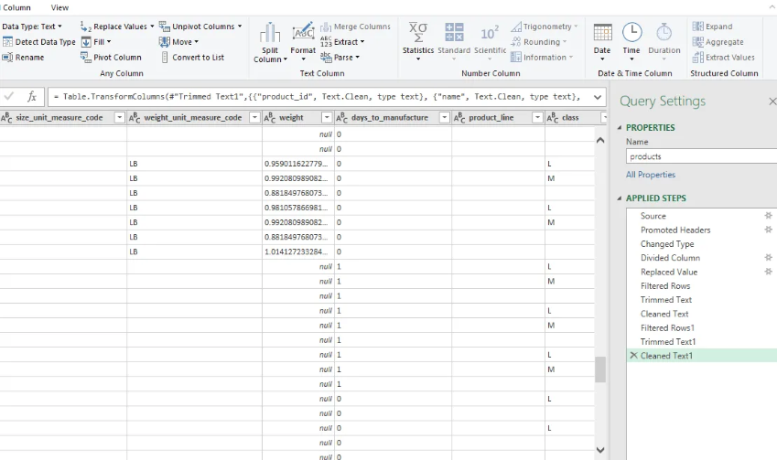
Transformation Challenges
DATA EXPLORATION AND VALIDATION

Slide 7
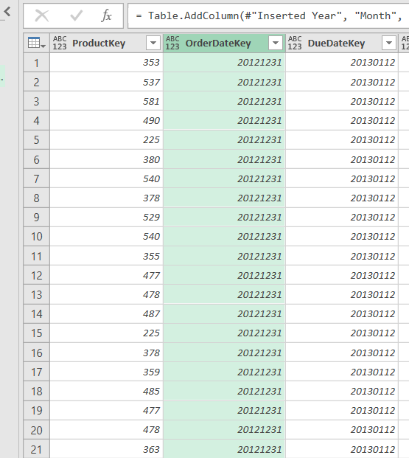
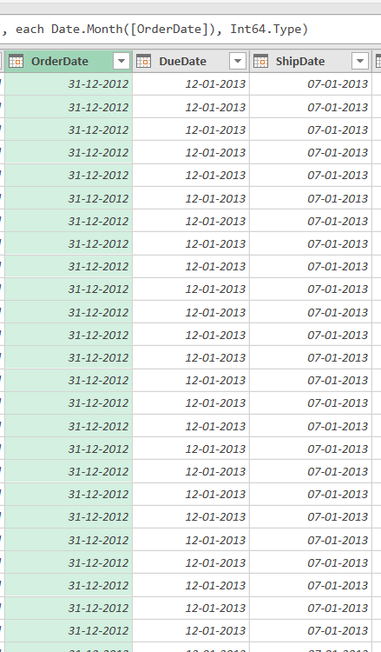
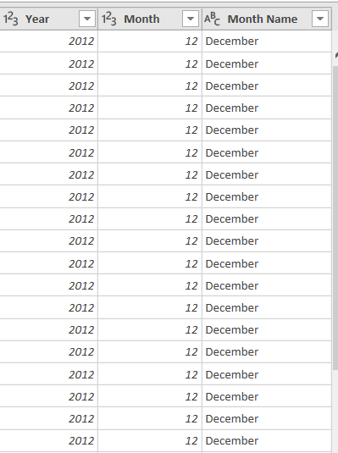
DATA CLEANING & TRANSFORMATION

Slide 8
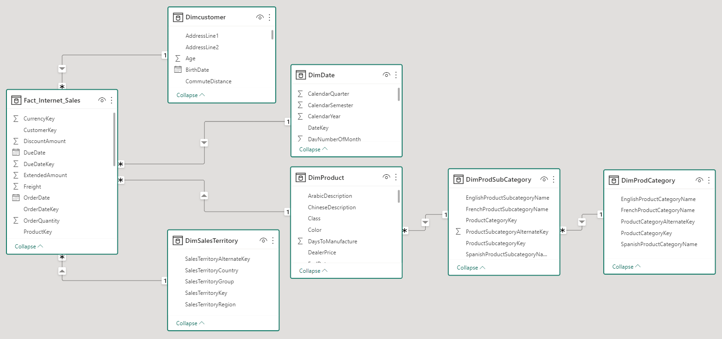
Data Model
Many to one Relationship(*1)
In a data model, a "many-to-one" relationship refers to a relationship between two entities where multiple instances of one entity (the "many" side) are associated with a single instance of another entity (the "one" side).

Slide 9
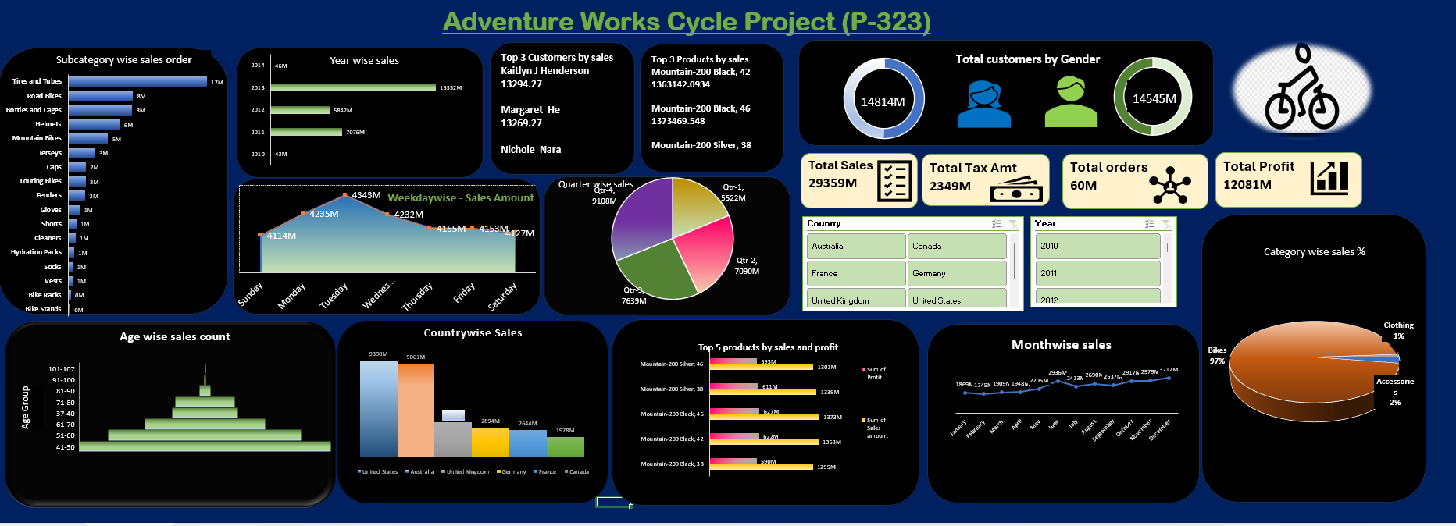
Dashboard Over View
Sales Analysis Dashboard

Slide 10


Conclusion :
Financial Strength:
Robust financials demonstrated through Total Revenue of $29.36 Million & Total Profit $12.6 million
Market Demand and Customer Base:
High order intake 60.35K indicate strong product demand.
With Diverse customer base 18.5 K showcases wide market reach.
Category and Product Performance:
Bikes being Top Category and key products Road bikes, Mountain bikes, etc.) significantly contribute to overall success
Geographical Impact:
Sales distribution across regions, with US & Australia as a major contributor, and opportunity in Canada to expand the business
Germany can be target regions with growing sales for enhanced market presence
Customer Insights:
Understanding customer demographics
Considering educations – bachelors & partial college
Occupations – professional & skilled manpower
Target high-performing customer segments for sustained growth.
Strategic Direction:
Analysis provides a foundation for strategic decision-making.
Adventure Works Cycles positioned to capitalize on strengths and navigate market challenges.

Slide 11

Marketing Strategies:
Targeted Campaigns Based on Category and Subcategory Insights
Product Optimization:
Enhance Product Lines Based on Top Product Performance
Geographical Expansion:
Explore Opportunities in High Sales Regions
Customer Segmentation:
Tailor Marketing to High-Performing Demographics
Data-Driven Decision Making:
Implement Ongoing Data Analysis for Informed Decisions
Supply Chain Optimization:
Optimize Supply Chain Based on Product Performance

Slide 12
THANK YOU

